Slide 1
AI Bootcamp
Impact of Education on Pay and
the Gender Gap
Project 1 - Team 10
May 16, 2024
Notes:
Talk Track:
Our EDA project assessed the impact of education on pay and the gender gap.

Slide 2

Executive Summary
Project scope defined, including project goals
EDA Approach & Methodology
Summary of project plan and exploratory data analysis process
Key Insights & Implications
Results of the analysis
Conclusion & Next Steps
Main takeaways and plan for future development
Notes:
Talk Track:
Here is what we’ll covering, aligning to the project requirements:
-Project Overview, including project goals
-EDA Approach & Methodology, providing an overview of the project plan and EDA process
-Key Insights & Implications, highlighting our main takeaways
-Conclusion & Next Steps, summarizing the main takeaways and additional opportunities

Slide 3
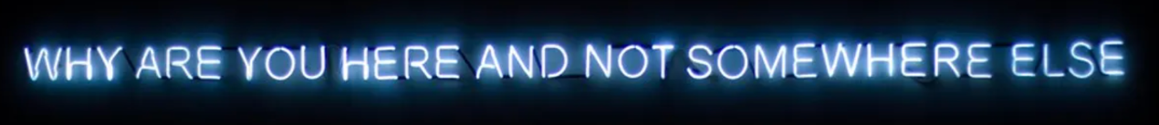


Executive Summary
Do you earn more with education?
^{Does it vary by gender?}
Notes:
Talk Track:
Why are you here and not somewhere else? We paid a good chunk of money to take this course, expecting to get exposure to the tools required to help us elevate and/or pivot our careers.
Our primary goal was to answer the following questions:
Do we earn more with education?
Does it vary by gender?
Have we bridged the gender pay gap over the past 20 years? If so, does the gap narrow depending on education level?
Does wage growth (over 20 years) vary by gender?
1. About the Project
The project aims to analyze the Employment data vs Education level, understand the trends, and develop forecast for the next 12 month period. The code was developed in Jupyter and Google Colab and present the steps the team took to draw insights from the data. The team utilized the most relevant technical aspects of Python libraries and use of Prophet to address the analytical requirements of the project. The eployment data was collected from The U.S. Bureau of Labor Statistics website. This is a US Government website with direct access to US residents and Citizens data from local and state reporting. This data summarize the employment salary vs education level for every State, Metro, and Zip code in the US from 2000 to 2024.

Slide 4





EDA Approach & Methodology
20 years
Salary
Education Level
Gender
Has the gender pay gap improved over the years?
Does it vary by education level?
Does wage growth vary by gender?
Project
Ideation
Data Sourcing & Transformation
Data
Analysis
Synthesis
-Manually transform data to usable format (CSV)
-Used Power BI to derive preliminary insights to confirm usability of data source
-Used Jupyter Notebook/Google Collab to build code
Notes:
Talk Track:
EDA Approach
We leveraged a US Bureau of Labor Statistics data set, spanning twenty years with salary, education, and gender as parameters.
The specific questions we wanted to touch upon were:
-Has the gender pay gap improved over the years? Does it vary by education level?
-Does wage growth vary by gender?
Methodology
We took the standard approach, kicking off with project ideation, and spending a bit of time sourcing data & transforming it manually to net out with one usable CSV file.
We then looked to quickly assess feasibility of our data set to derive preliminary insights. Once we felt comfortable with our data set, we proceeded to leverage tools available (Power BI, Python) to build/code visualizations.
We took a top-down, bottom-up approach to come up with a narrative, synthesizing information/charts, and ensuring they answer the questions we set out to address.
Dataset
The dataset for the project was sourced from this public URL: https://www.bls.gov/data/#employment
Tools for analysis
Jupyter Notebook
Google Collab [https://colab.google/]
2. The Approach
Data Management
The raw data was downloaded from the original source into an excel tab separated values for the initial analysis. The original data file had multiple sources of data in one column. After a quick review of the data, the initial file was further explored analyzed which were required for our analysis. The new layout was stored as a standard CSV file which served as an input for the rest of the analysis.
Github for code repository

Slide 5
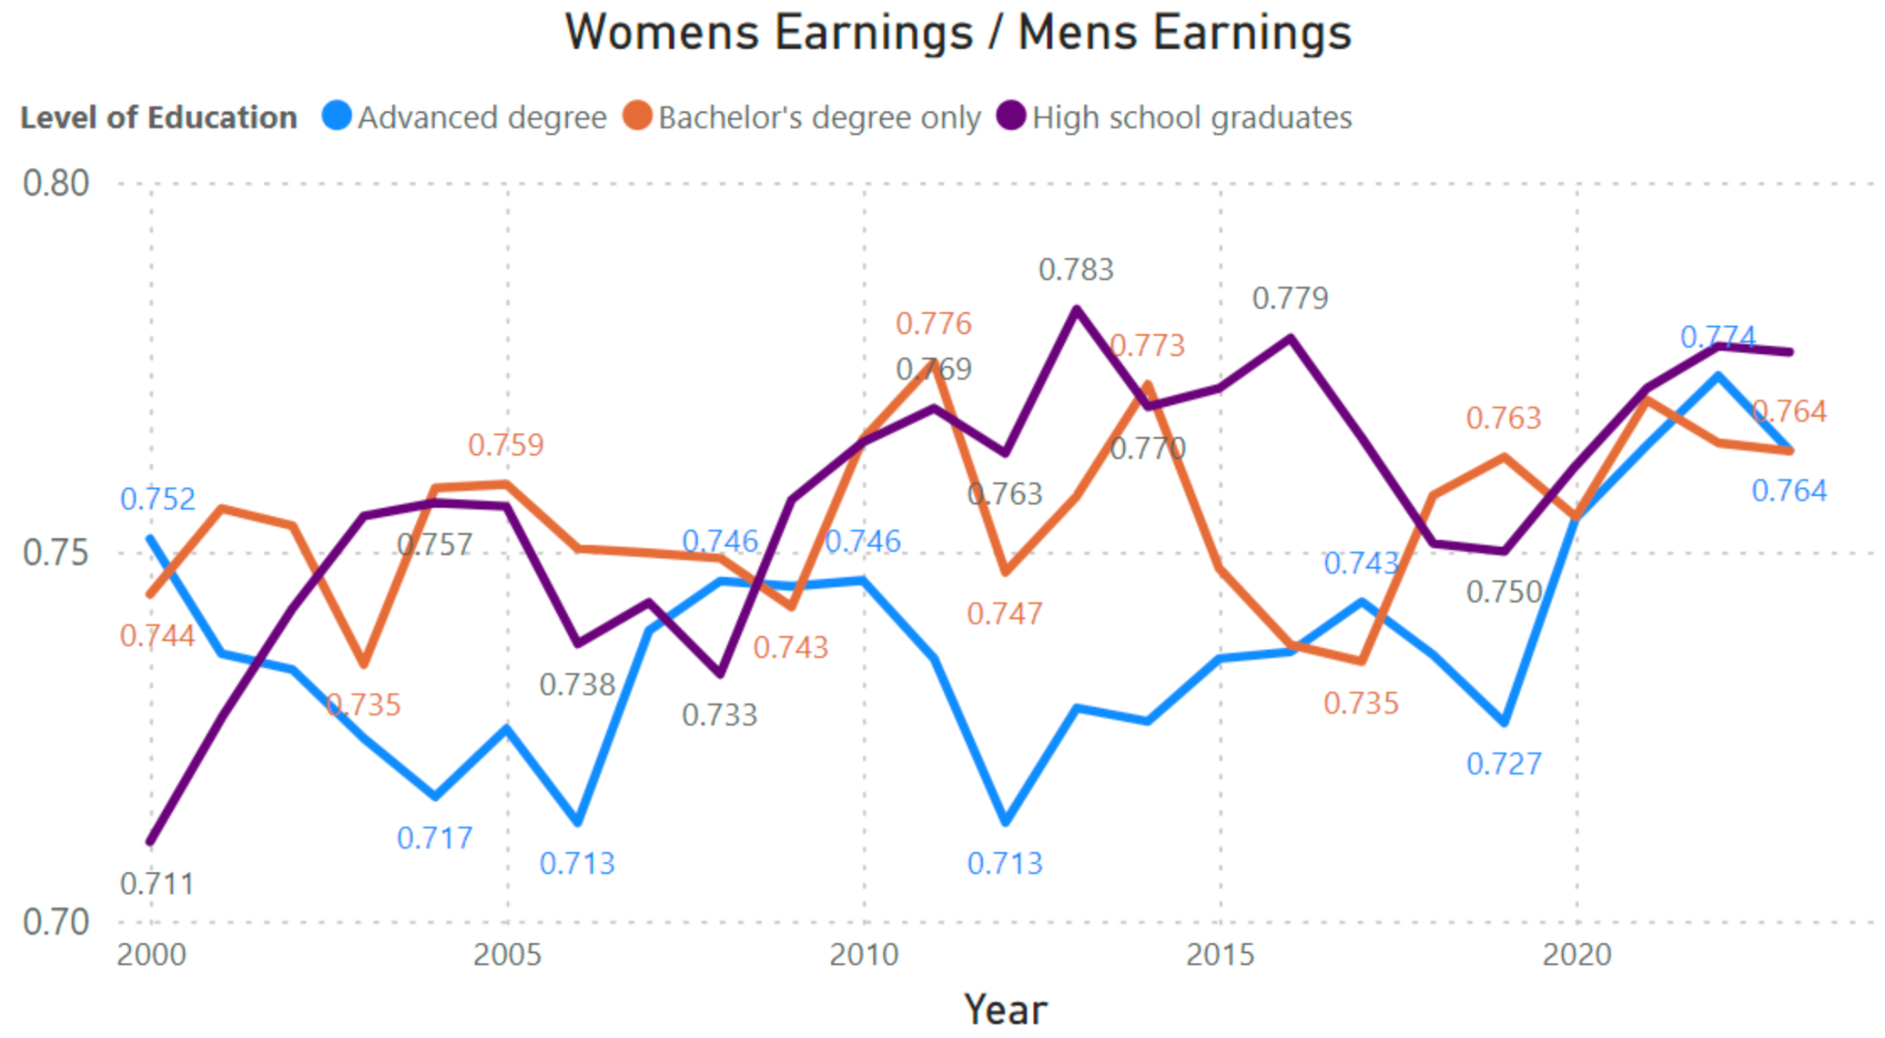
Gender Gap Is Consistent,
With No Variation Across Education Levels
Insight
TBC
Implication
TBC

Slide 6
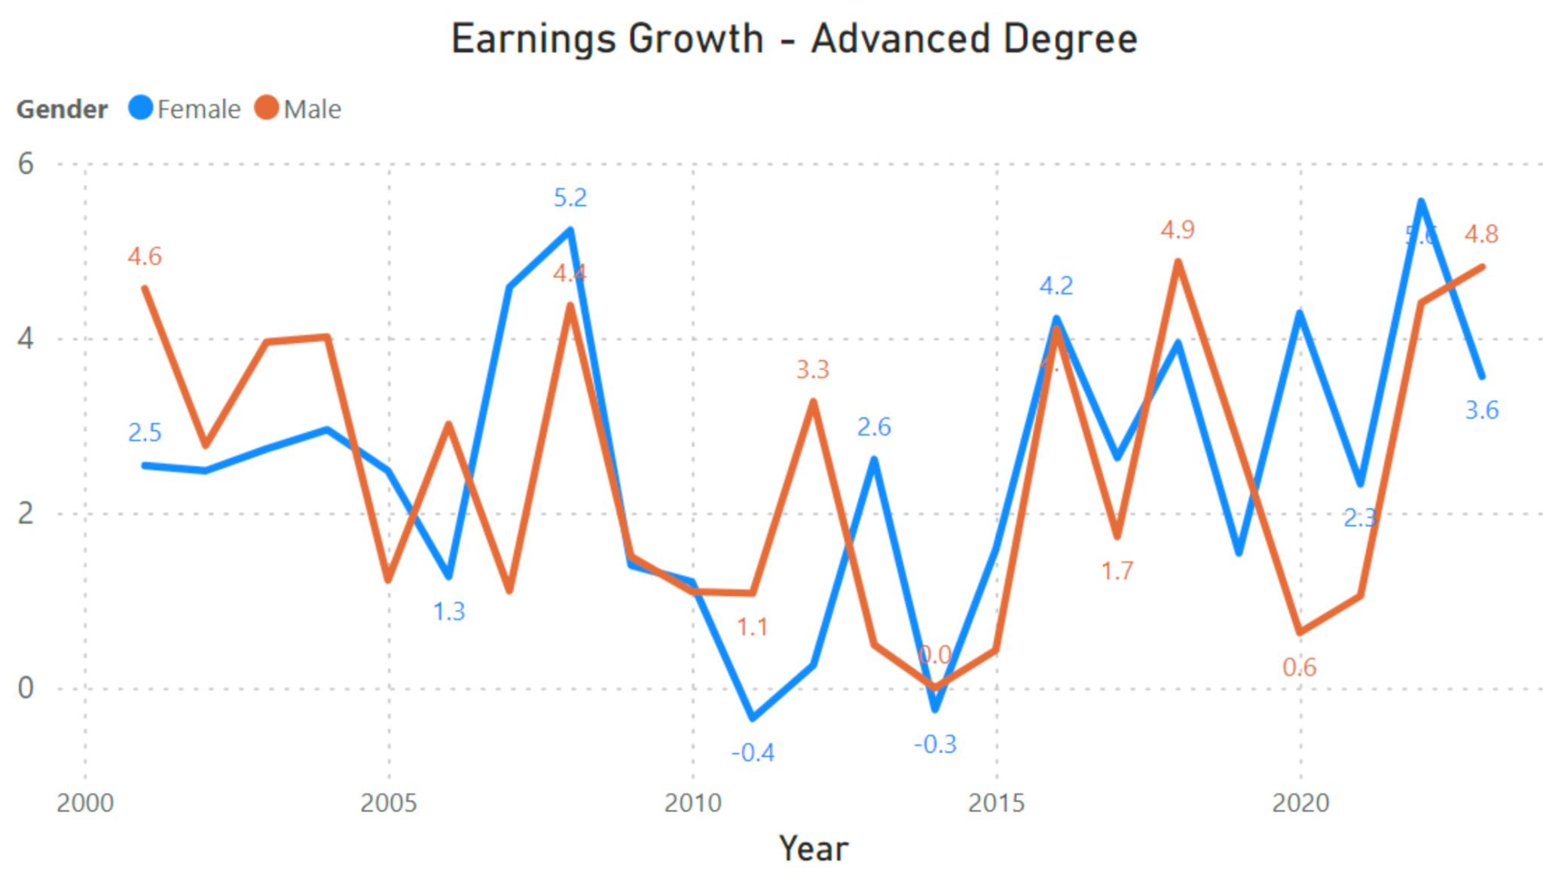

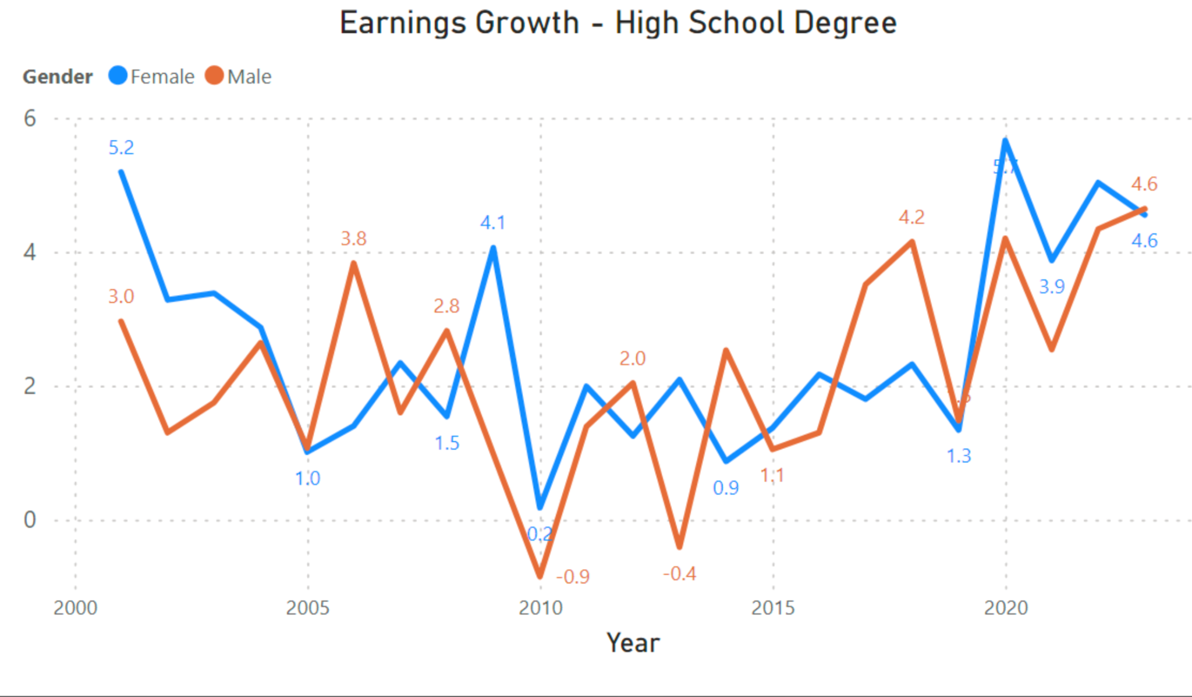
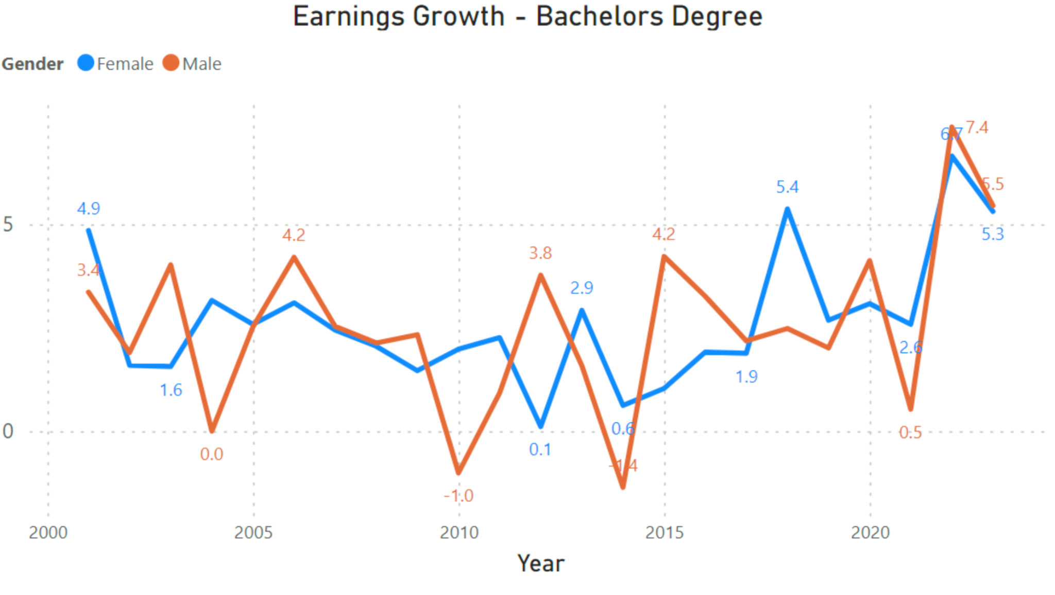
Wage Growth Seems To Be Generally Aligned Across Genders,
Perhaps Lagged For Females Across Lower Education Levels
Insight
TBC
Implication
TBC

Slide 7




Conclusion & Next Steps
Level of education does not seem to impact pay (at least in aggregate)
While the gender pay gap has improved, growth rate of salary for men is noticeably higher than that of female
Analyze additional data dimensions to get more granular insights:
Ethnicity
Profession/Industry
Age
Family Status
Geo
Build a model to forecast pay trends by various segments to help bring awareness to further make progress in achieving pay equity
Notes:
Talk Track:
In summary, level of education does not seem to impact pay, at least in aggregate. Further, while the gender pay gap has improved, growth rate of salary for men is noticeably higher than that of female.
Based on the findings of this analysis, we identified some follow-up opportunities:
Analyze additional data dimensions to get more granular insights
Build a model to forecast pay trends by various segments to help bring awareness towards more effort needed to achieve pay equity

Slide 8
Thank You!
Notes:
Questions?

Slide 9
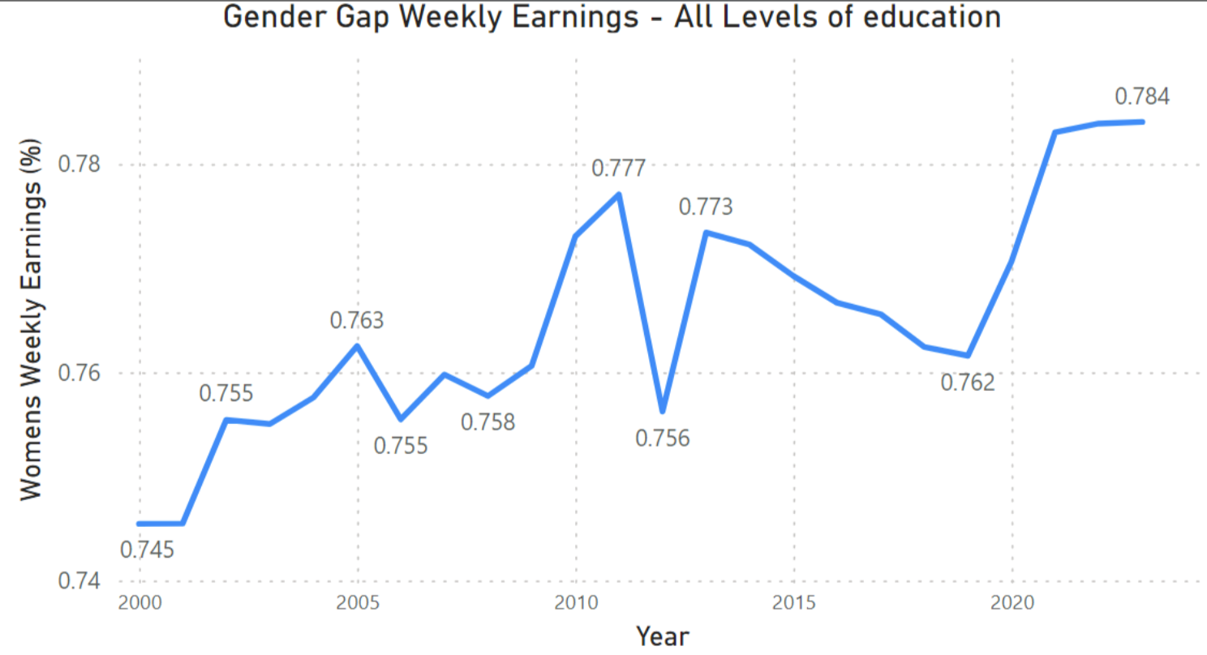
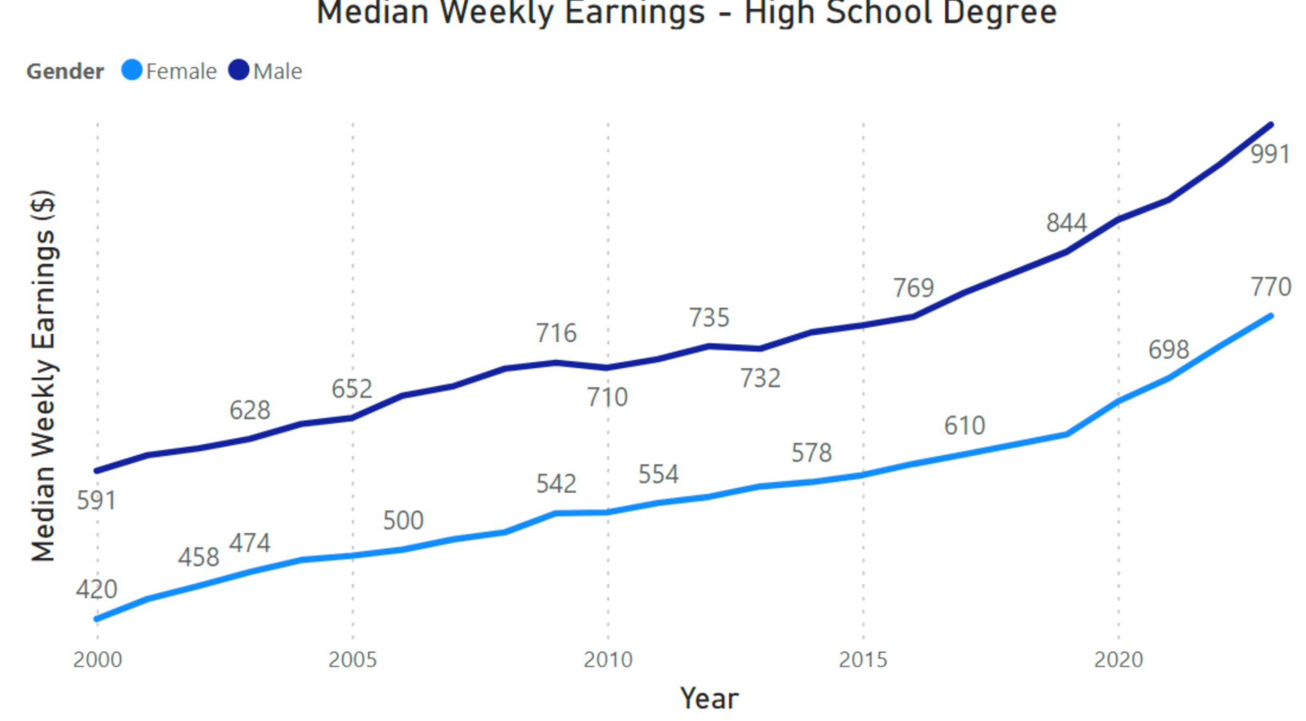
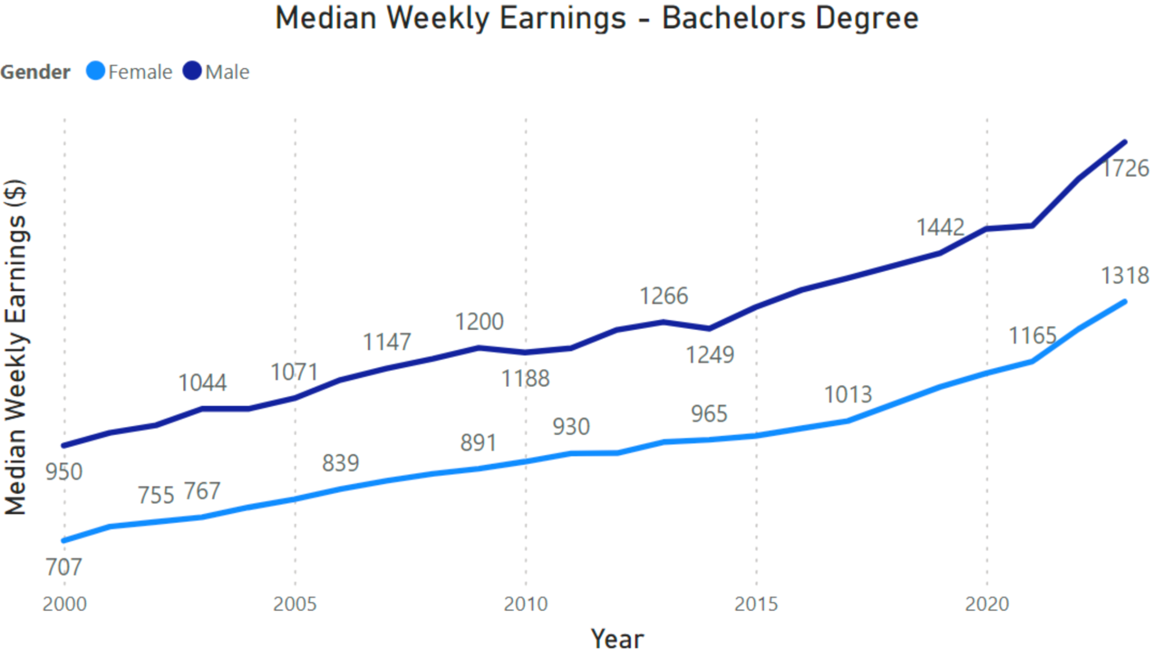
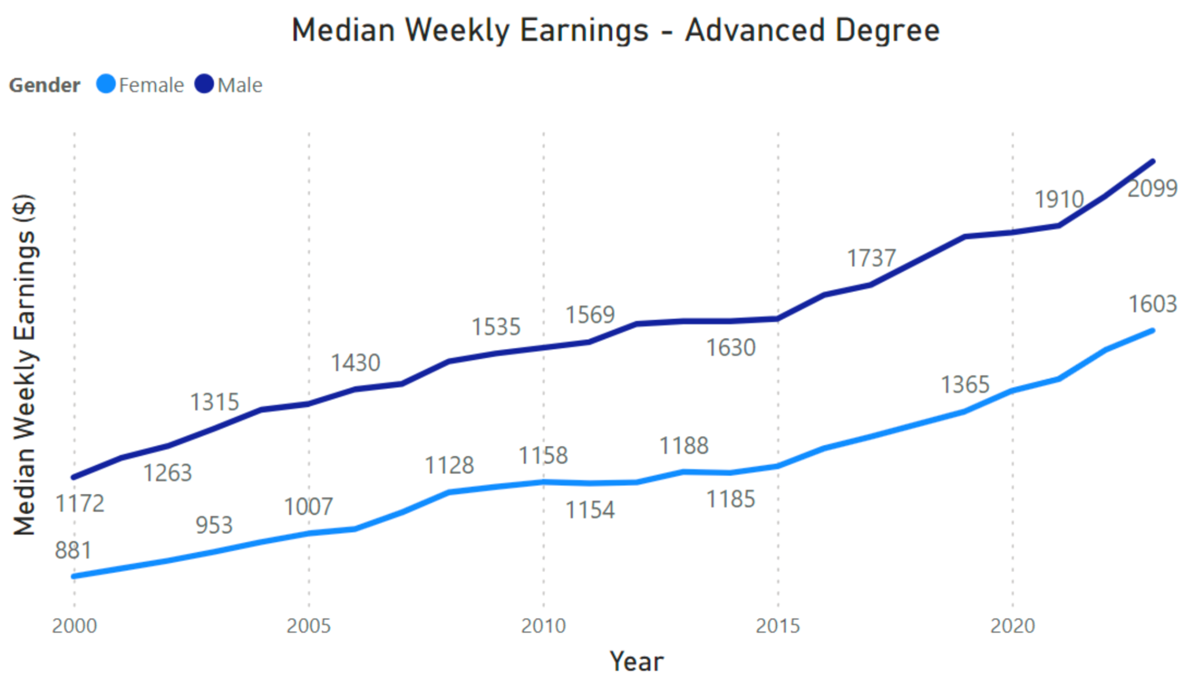
Gender seems to ha
Insight
TBC
Implication
TBC

Slide 10
Conclusion & Next Steps
Analysis Approach
Data Profiling and Review:
Understand the raw data by profiling the data and reviewing the published data dictionary.
Opportunity Identification:
Identify opportunities for analysis and prediction within the dataset.
Data Preparation:
Prepare data for analysis by reading relevant data using Pandas.
Trend Identification:
Identify trends in data using Matplotlib libraries.
Insight Seeking:
Seek insights from the data to inform decision-making.
Prediction:
Utilize Google's Colab and 'Prophet' to predict trends based on historical data.
Conclusion Drawing:
Draw conclusions based on the analysis and predictions to inform future actions.

Slide 11
Focus Areas of Analysis
Despite encountering limitations in the quality of available data, the project team has strategically prioritized their efforts based on time and project constraints. The team's focus areas include:
National Trends in Education Levels:
Analyze trends across all education levels by degree or level of education, ethnicity, and sex.
Compare these trends to levels of income to identify correlations and insights.
Top Income Earners and Education Type:
Explore the relationship between top income earners and their respective education types.
Identify patterns and correlations to gain a deeper understanding of income generation across different educational backgrounds.
Sebastian Fajardo
Trends in Top 5 Education Avenues:
Investigate trends in the top 5 education avenues or degrees over the specified timeframe.
Assess the relative levels of income associated with these education paths to discern patterns and potential correlations.
Income Potential by Sex and Ethnicity:
Analyze income potential by sex and ethnicity within the context of education completion.
Explore competitive dynamics within the education landscape to understand disparities and opportunities.
Curve Fitting and Prediction for Unemployment Rates:
Utilize curve fitting techniques to analyze historical unemployment rates.
Develop predictive models to forecast unemployment rates for the next 12-month period, enabling proactive decision-making and resource allocation.
By focusing on these key areas, the project team aims to extract meaningful insights and actionable recommendations despite the challenges posed by the data quality and project constraints.

Slide 12
Missed Opportunities:
Due to time constraints, we were unable to leverage the available data for expanding our analysis to include correlation studies. Additionally, we had intended to explore the impact of the Covid pandemic on the employment market; however, this investigation was not feasible within the current timeframe. These analyses will be deferred for future endeavors.
To enhance our exploration of correlations between key variables, we recognize the need for additional data sources. Supplementing the labor department market data with demographic, income, or census data would enrich our analysis and provide a more comprehensive understanding of the factors influencing the employment landscape.

Slide 13
Data Charts Infographics
Venus
Mars
Saturn
90%
75%
60%
70%
40%
85%
80%
100%
60%
2020
2021
2022
Venus is the second planet from Sun
Mars is a cold place full of iron oxide dust
Saturn is a gas giant and has several rings

Slide 14
Data Charts Infographics
1000
900
Product 1
800
Venus is the second planet from the Sun
700
600
500
400
Product 2
300
Saturn is composed of hydrogen and helium
200
100
2020
2021
2022
2023
2024

Slide 15
Data Charts Infographics
Saturn
Venus
Jupiter
+90
Venus has a nice name and is the second planet from the Sun
Mars
+80
Earth
+70
Venus
+60
Saturn
+50
Saturn is the ringed planet, composed of hydrogen and helium
Mars
Despite being red, Mars is a cold planet full of iron oxide dust

Slide 16
Data Charts Infographics
80%
90%
10%
60%
70%
50%
2020
2021
2022
2023
2024
2025

Slide 17
Data Charts Infographics
150€
100€
100€
70€
Quarter 1
Quarter 2
Quarter 3
Quarter 4
Venus has a nice name
Mars is a cold place
Jupiter is the biggest planet
Saturn has several rings

Slide 18
Data Charts Infographics
Mercury is the smallest planet
Mercury
100%
Venus has a beautiful name
Venus
50%
Earth
60%
Earth in the only planet with life
Mars is actually a cold place
Mars
30%
Saturn is a gas giant and has rings
Saturn
80%

Slide 19
Data Charts Infographics
Mars
60%
Despite being red, Mars is actually a cold place full of iron oxide dust
Venus
80%
Venus has a beautiful name, but it’s terribly hot, even hotter than Mercury
Neptune
50%
Neptune is the fourth-largest planet by diameter in the Solar System

Slide 20
Data Charts Infographics
100%
60%
90%
80%
Venus
Mars
Mercury
Saturn
Venus has a beautiful name
Mars is actually a cold place
Mercury is the smallest planet
Saturn is a gas giant and has rings

Slide 21
Data Charts Infographics
Product 1
Product 2
Venus has a beautiful name and is the second planet from the Sun
Despite being red, Mars is a cold place full of iron oxide dust
Product 3
Product 4
Mercury is the closest planet to the Sun and the smallest one
Jupiter is a gas giant and the biggest planet in the Solar System

Slide 22
Data Charts Infographics
75%
50%
30%
80%
Saturn
Mercury
Mars
Jupiter
It’s composed of hydrogen and helium
Mercury is the closest planet to the Sun
Despite being red, Mars is a cold place
Jupiter is a gas giant and the biggest planet

Slide 23
Data Charts Infographics
Quarter 1
Quarter 2
15%
Venus has a beautiful name and is the second planet from the Sun
Despite being red, Mars is a cold place full of iron oxide dust
15%
25%
Quarter 3
Quarter 4
35%
Mercury is the closest planet to the Sun and the smallest one
Jupiter is a gas giant and the biggest planet in the Solar System

Slide 24
Data Charts Infographics
Venus
50%
Mars
Venus has a beautiful name and is the second planet from the Sun
Despite being red, Mars is a cold place full of iron oxide dust
35%
10%
Mercury
Jupiter
Mercury is the closest planet to the Sun and the smallest one
15%
Jupiter is a gas giant and the biggest planet in the Solar System

Slide 25
Data Charts Infographics
Venus
75%
Venus has a beautiful name and is the second planet from the Sun
65%
50%
Jupiter
Jupiter is a gas giant and the biggest planet in the Solar System
Mercury
Mercury is the closest planet to the Sun and the smallest of them all

Slide 26
Data Charts Infographics
50%
60%
Venus
Mars
Venus has a beautiful name and is the second planet from the Sun
Despite being red, Mars is a cold place full of iron oxide dust
70%
80%
Mercury
Jupiter
Mercury is the closest planet to the Sun and the smallest one
Jupiter is a gas giant and the biggest planet in the Solar System

Slide 27
Data Charts Infographics
Venus
Venus has a beautiful name and is the second planet from the Sun
80%
Jupiter
Jupiter is a gas giant and the biggest planet in the Solar System
70%
Mercury
55%
Mercury is the closest planet to the Sun and the smallest of them all

Slide 28
Data Charts Infographics
Venus
Mars
Venus has a beautiful name and is the second planet from the Sun
Despite being red, Mars is a cold place full of iron oxide dust
Mercury
Jupiter
Mercury is the closest planet to the Sun and the smallest one
Jupiter is a gas giant and the biggest planet in the Solar System

Slide 29
Data Charts Infographics
Mercury
5/10
Mercury is the closest to the Sun
Venus
8/10
Venus is the second planet from the Sun
Earth
4/10
Planet Earth is the only one with life
Mars
7/10
Mars is a cold place full of iron oxide dust

Slide 30
Data Charts Infographics
January
Project 1
Project 2
February
Project 3
March
Project 4
April
May
Planet Venus
Venus has a beautiful name and is the second planet from the Sun. It is terribly hot, even hotter than Mercury
June
0
10
15
20
25
30

Slide 31
Data Charts Infographics
71+
70
60
50
40
30
20
100%
75%
50%
25%
0%
25%
50%
75%
100%
Male
Female

Slide 32
Data Charts Infographics
Mercury
Venus
Earth
Mars
Jupiter
Saturn
JAN
FEB
MAR
APR
MAY
JUN
JUL
AUG
SEP
OCT
NOV
DEC

Slide 33
Data Charts Infographics
Venus
Venus has a beautiful name and is the second planet from the Sun
9,000
Mercury
Mercury is the closest planet to the Sun and the smallest one
5,000
Mars
Despite being red, Mars is a cold place full of iron oxide dust
4,000
Jupiter
Jupiter is a gas giant and the biggest planet in the Solar System
8,000

Slide 34
Data Charts Infographics
400
400
200
Mercury
Q4
Mercury is the smallest planet
600
100
300
Q3
Venus
200
300
500
Venus is the second planet from the Sun
Q2
300
500
200
Q1
Earth
Earth is the only planet with life
100
300
500
700
900

Slide 35
Data Charts Infographics
+50
Losses
+40
+30
Mercury is the closest planet to the Sun and the smallest one
+20
+10
Profits
-10
-20
Venus has a beautiful name and is the second planet from the Sun
-30
-40
-50

Slide 36
Data Charts Infographics
1000
200
1000
900
800
400
700
600
500
400
100
300
300
200
100
0
Venus
Mars
Jupiter
Saturn
Earth
Venus has a beautiful name
Mars is a cold place
Jupiter is the biggest planet
Saturn has several rings
Earth is the planet with life

Slide 37
Data Charts Infographics
Product 1
Product 2
1000
900
800
700
600
500
400
300
200
100
Jan
Feb
Mar
Apr
May
Jun
Jul
Aug
Sep
Oct
Nov
Dec

Slide 38
Data Charts Infographics
Result 1
500
Venus is the second planet from the Sun
400
Result 2
300
Saturn is composed of hydrogen and helium
200
Result 3
100
Mars is a cold planet full of iron oxide dust
Item 1
Item 2
Item 3
Item 4

Slide 39
Data Charts Infographics
Jan
Feb
Mar
Apr
May
Jun
Jul
Aug
Sep
Oct
Nov
Dec
Product 1
Product 2

Slide 40
Data Charts Infographics
50M
Product 1
Venus is the second planet from the Sun
40M
30M
Product 2
Saturn is composed of hydrogen and helium
20M
10M
Product 3
Mars is a cold planet full of iron oxide dust
Q1
Q2
Q3
Q4

Slide 41
Data Charts Infographics
100
50
60
70
90
40
Mercury
Venus
Earth
Mars
Jupiter
Saturn

Slide 42
Data Charts Infographics
$5000
$4000
$3000
$2000
$1000
Item 1
Item 2
Item 3
Item 4
Item 5

Slide 43
Instructions for use (free users)
In order to use this template, you must credit Slidesgo by keeping the Thanks slide.
You are allowed to:
Modify this template.
Use it for both personal and commercial purposes.
You are not allowed to:
Sublicense, sell or rent any of Slidesgo Content (or a modified version of Slidesgo Content).
Distribute this Slidesgo Template (or a modified version of this Slidesgo Template) or include it in a database or in any other product or service that offers downloadable images, icons or presentations that may be subject to distribution or resale.
Use any of the elements that are part of this Slidesgo Template in an isolated and separated way from this Template.
Delete the “Thanks” or “Credits” slide.
Register any of the elements that are part of this template as a trademark or logo, or register it as a work in an intellectual property registry or similar.
For more information about editing slides, please read our FAQs or visit Slidesgo School:
https://slidesgo.com/faqs and https://slidesgo.com/slidesgo-school

Slide 44
Instructions for use (premium users)
In order to use this template, you must be a Premium user on Slidesgo.
You are allowed to:
Modify this template.
Use it for both personal and commercial purposes.
Hide or delete the “Thanks” slide and the mention to Slidesgo in the credits.
Share this template in an editable format with people who are not part of your team.
You are not allowed to:
Sublicense, sell or rent this Slidesgo Template (or a modified version of this Slidesgo Template).
Distribute this Slidesgo Template (or a modified version of this Slidesgo Template) or include it in a database or in any other product or service that offers downloadable images, icons or presentations that may be subject to distribution or resale.
Use any of the elements that are part of this Slidesgo Template in an isolated and separated way from this Template.
Register any of the elements that are part of this template as a trademark or logo, or register it as a work in an intellectual property registry or similar.
For more information about editing slides, please read our FAQs or visit Slidesgo School:
https://slidesgo.com/faqs and https://slidesgo.com/slidesgo-school

Slide 45
Infographics
You can add and edit some infographics to your presentation to present your data in a visual way.
Choose your favourite infographic and insert it in your presentation using Ctrl C + Ctrl V or Cmd C + Cmd V in Mac.
Select one of the parts and ungroup it by right-clicking and choosing “Ungroup”.
Change the color by clicking on the paint bucket.
Then resize the element by clicking and dragging one of the square-shaped points of its bounding box (the cursor should look like a double-headed arrow). Remember to hold Shift while dragging to keep the proportions.
Group the elements again by selecting them, right-clicking and choosing “Group”.
Repeat the steps above with the other parts and when you’re done editing, copy the end result and paste it into your presentation.
Remember to choose the “Keep source formatting” option so that it keeps the design. For more info, please visit Slidesgo School.

